Slide 1



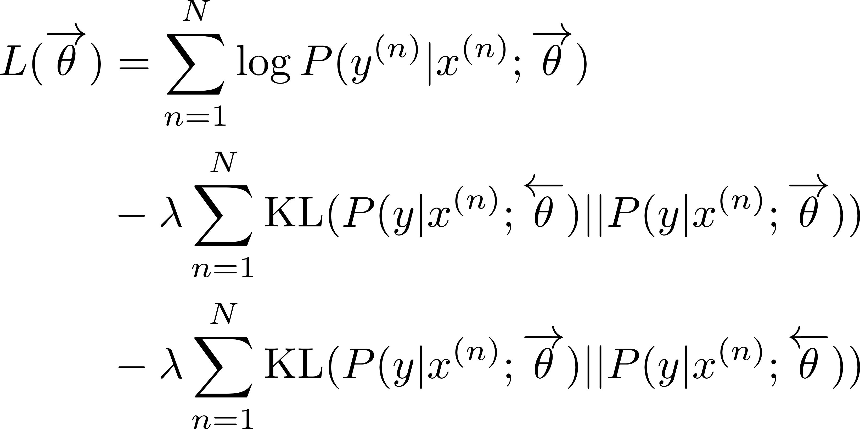
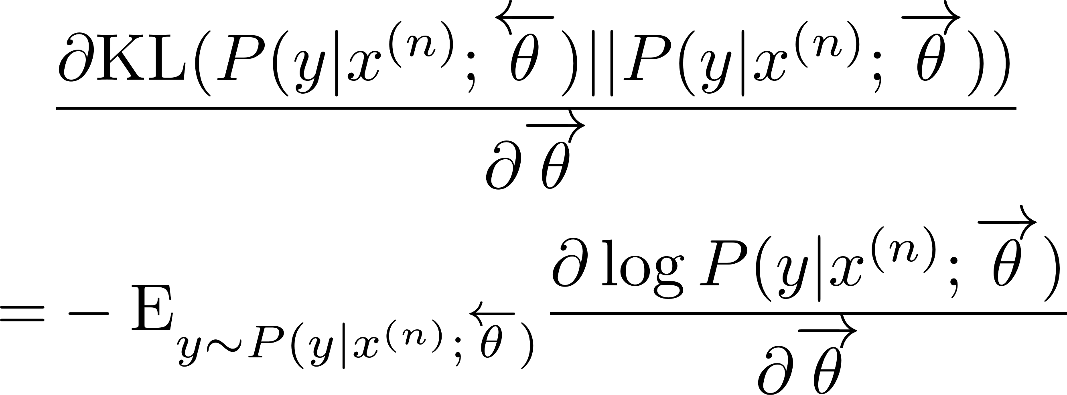
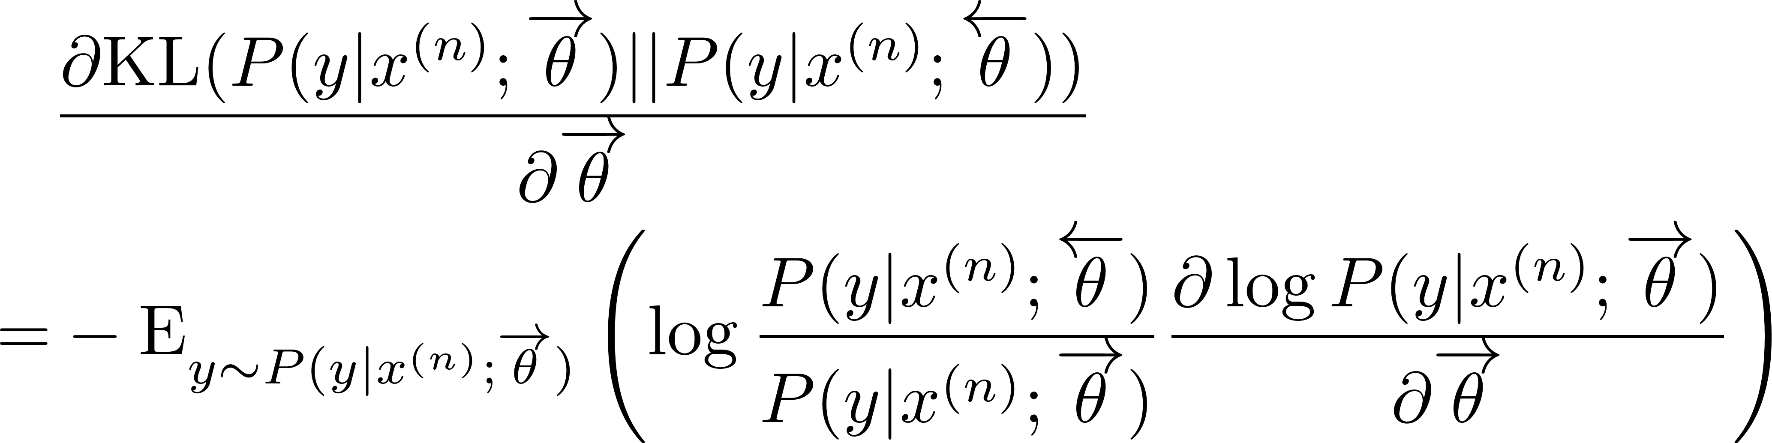
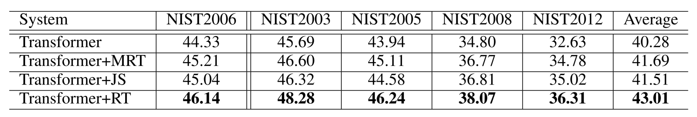
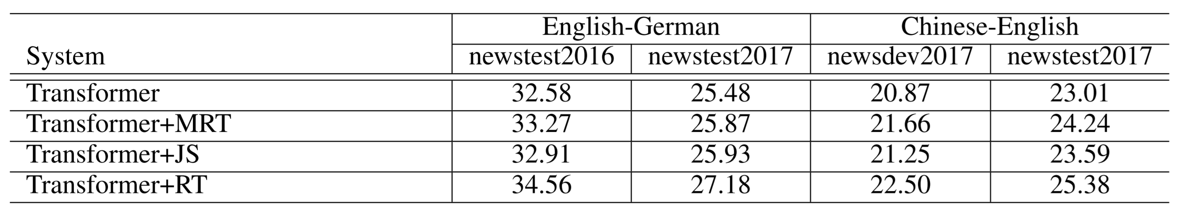
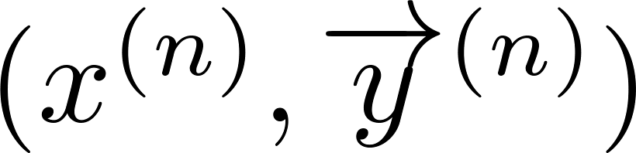
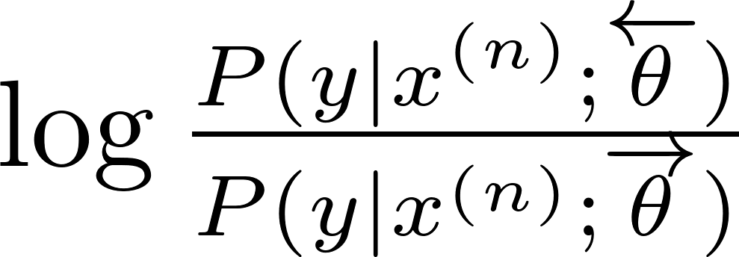
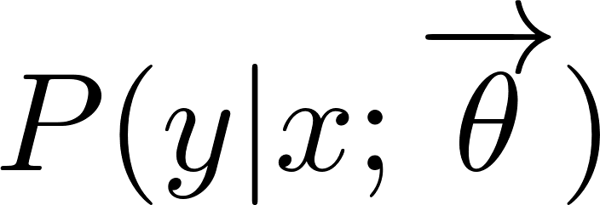
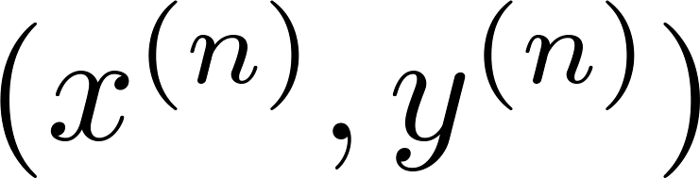
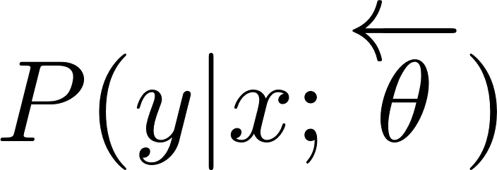
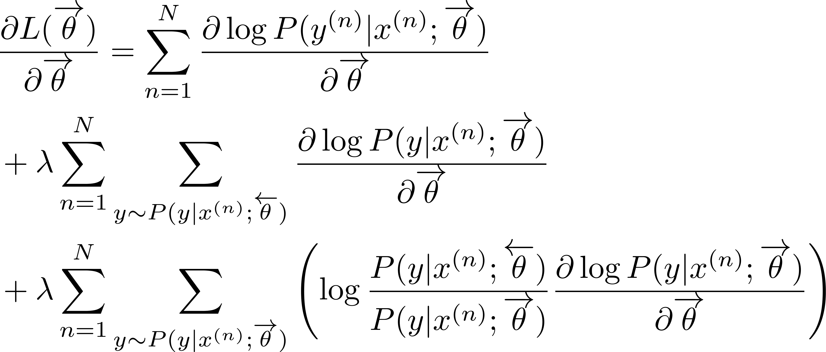
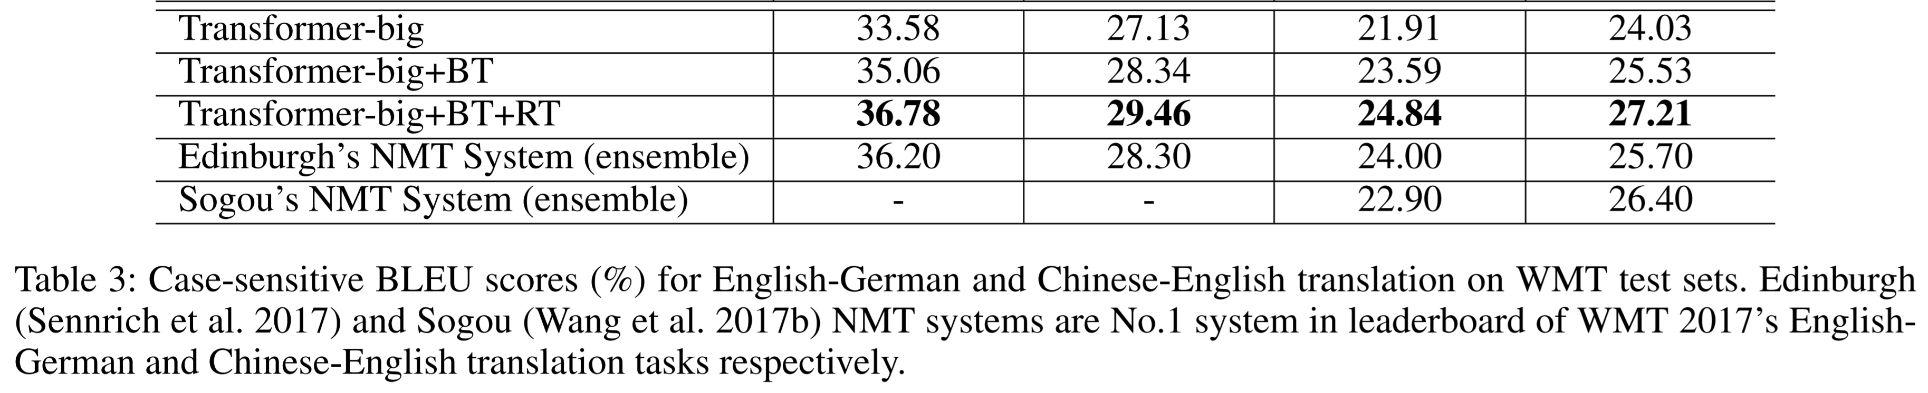
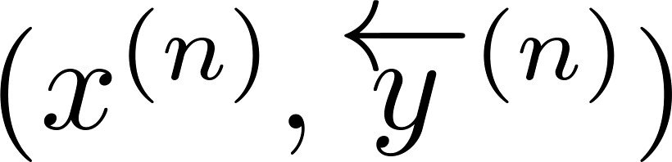
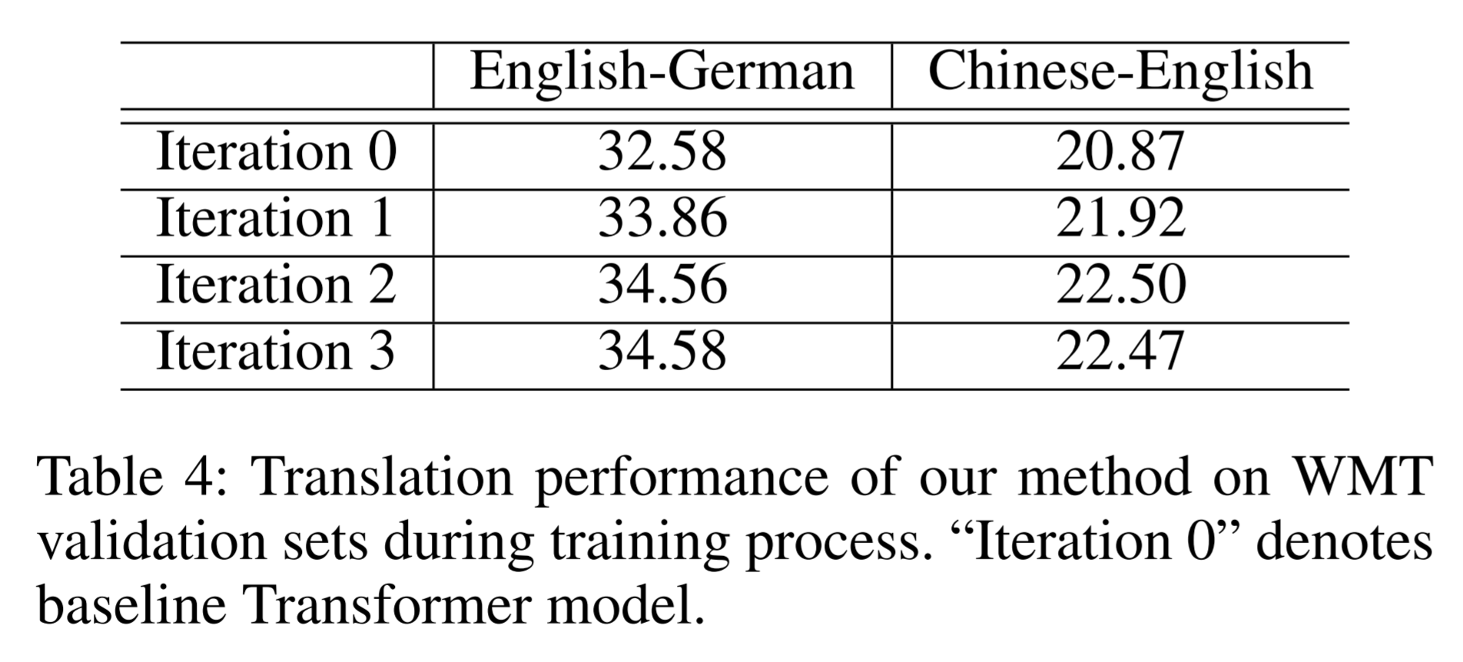
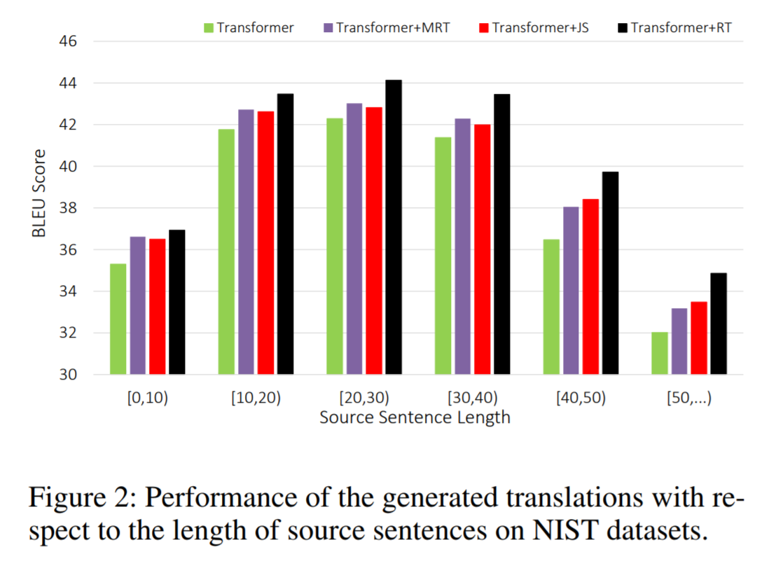
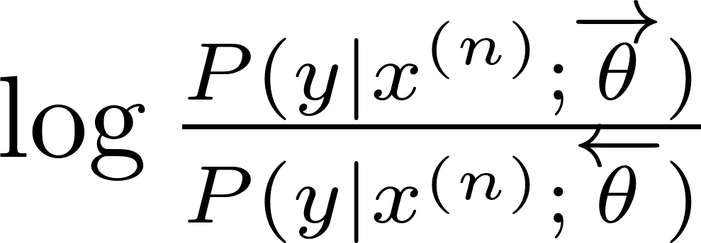




















Regularizing Neural Machine Translation by
Target-bidirectional Agreement
Zhirui Zhang¹, Shuangzhi Wu², Shujie Liu³, Mu Li³, Ming Zhou³ and Tong Xu¹
¹University of Science and Technology of China
²Harbin Institute of Technology ³Microsoft Research Asia
¹zrustc11@gmail.com, tongxu@ustc.edu.cn ²³{v-shuawu,shujliu,muli,mingzhou}@microsoft.com
Motivation: Exposure Bias Problem
NMT model is only trained with golden bilingual sentences
Output sentence is auto-regressively generated word by word during decoding
Previous errors will mislead the generation of the subsequences
Errors will be quickly amplified
Training
Decoding
Translate from Left to Right
Translate from Right to Left
Louis told KGO that Frank, who used to work as a cook in Boston, had found a job in a restaurant.
Louis told KGO, had found a job as a pipeline chef at a restaurant in San Francisco .
Louis told KGO that Frank , who used to
. Francisco San in restaurant a at chef pipeline
$$⊕$$
$$⊕$$
$$⊕$$
$$⊕$$
$$⊕$$
$$⊕$$
$$⊕$$
$$⊕$$
$$⊕$$
$$⊕$$
$$⊕$$
$$⊕$$
$$⊕$$
$$⊕$$
$$⊕$$
$$⊕$$
$$⊕$$
$$⊕$$
Louis 对 KGO 表示 , 之前 在 波士顿 做 厨师 的 Frank 在 旧金山 的 餐馆 找到 一 份 流水线 厨师 的 工作 .
Louis 对 KGO 表示 , 之前 在 波士顿 做 厨师 的 Frank 在 旧金山 的 餐馆 找到 一 份 流水线 厨师 的 工作 .
Target-bidirectional Agreement Regularization
Introduce two Kullback-Leibler (KL) divergence regularization terms
Experiments
Evaluate our approach on three datasets
NIST OpenMT for Chinese-English
WMT17 for English-German and Chinese-English
NMT systems
Transformer: the-state-of-art NMT system (Vaswani et al. 2017)
Transformer + MRT: minimax risk training (Shen et al. 2016)
Transformer + JS: re-ranking the results from bidirectional models (Liu et al. 2016)
Transformer + RT: our method
Evaluation on NIST Corpora
Evaluation on WMT17 Corpora
Combining with Back-Translation Method
Monolingual data: randomly select 5M German sentences and 12M English sentences from “New Crawl: articles from 2016”
Weight
Agreement Regularization (R2L → L2R)
Agreement Regularization (L2R → R2L)
Pseudo Data
Sampling
Scoring
3
Bilingual Data
L2R Model
1
R2L Model
2
1
2
Sampling
3
Pseudo Data
Pseudo Data
Analysis
Effect of Joint Training
Performance on Long Sentences
Sampling
Scoring
3
Bilingual Data
2
L2R Model
1
1
R2L Model
2
3
1
2
Scoring
Sampling
1
2
3
Pseudo Data
3

